Slide 1
September 23, 2013
AP Literature and Composition

Slide 2
September 23, 2013
Circle up the desks…
First Roundtable discussion involving CRIMINALS
Comparison to Raskolnikov?

Slide 3
Objectives
Examine pros and cons of the death penalty, analyze the behavior of the unabomber and “The Dark Knight Murderer”, and consider the insanity plea.
Synthesize this information and consider all factors when comparing these people to Raskolnikov.

Slide 4
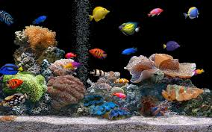
Did YOU Know?
Topless saleswomen are legal in Liverpool, England, but only in tropical fish stores.

