Slide 1
AP ENGLISH LITERATURE & COMPOSITION
FOR THE PREPARED
Not just
THE ELITE

Slide 2
AP and College Success™
Students who take AP courses and exams are much more likely than their peers to complete a bachelor’s degree in four years or less.
Source: Camara, Wayne (2003).
College Persistence, Graduation, and Remediation. College Board Research Notes (RN-19). New York, NY:
College Board.
Notes:
Students who take AP courses and exams are much more likely than their peers to complete a bachelor’s degree in four years or less.
Source: Camara, Wayne. (2003). College Persistence, Graduation, and Remediation. College Board Research Notes (RN-19). New York, NY: College Board.

Slide 3
Factors Influencing
Admission Decisions–2001
NACAC Admission Trends Survey, 2001

Slide 4
"Education is what survives when what has been learned has been forgotten."
B.F. Skinner.

Slide 5
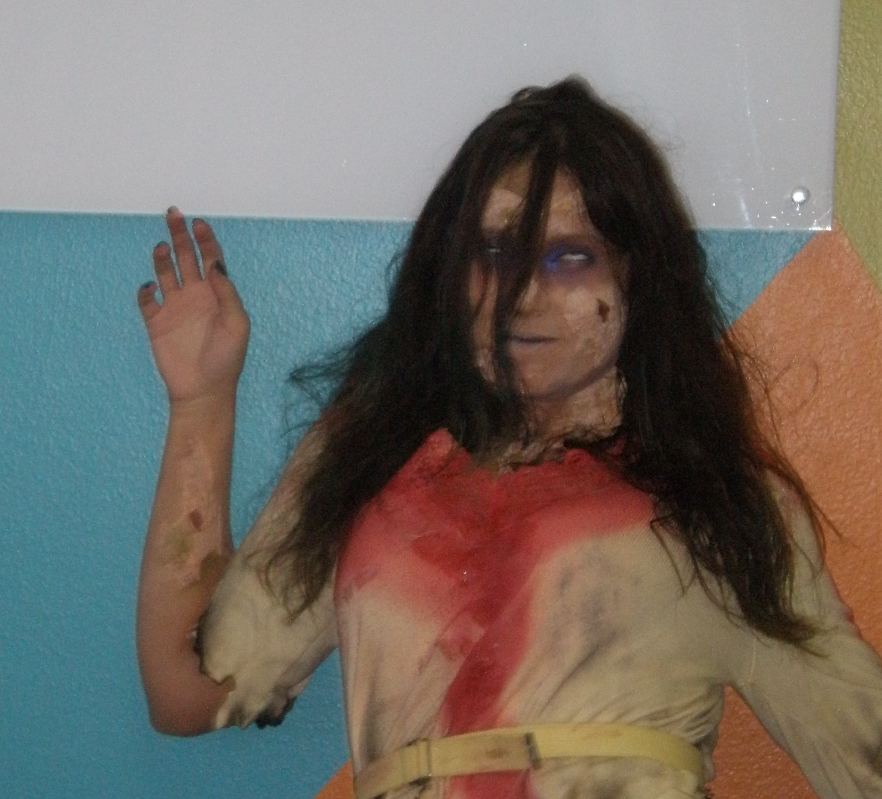
KNOW THE
ENEMY
The AP English Literature
and Composition Exam

Slide 6
WHAT DO THE SCORES MEAN?
5 = extremely well qualified
4 = well qualified
3 = qualified
2 = possibly qualified
1 = no recommendation
remember, AP© exam is an EXIT exam

Slide 7
WHAT DO THE SCORES MEAN?
5 = COLLEGE A
4 = COLLEGE A-/B+/B
3 = COLLEGE B-/C+/C
2 = COLLEGE C-/D+
1 = COLLEGE D or lower
remember, AP© exam is an EXIT exam

Slide 8
English Lit. and Comp. two parts
1 hour long
Multiple choice
45% of total score
50 to 60 multiple choice questions
  Each question has five choices
  No Penalty for wrong answers
2 hours long
Free response
55% of total score
Three essays
  Poetry selection
  Prose selection
  Open question

Slide 9
Scoring the Multiple Choice
Correct answers count 1 point each
Blanks (no response) count zero
Wrong answers count zero
About 56% is the minimum needed
  The multiple choice section is scored before the essays are read

Slide 10
Scoring the essays
Each essay is scored on a zero to 9 scale
Each essay is worth 18.33% of the exam
A score of 5 is the minimum acceptable
Essays are read by college English professors and high school AP teachers
About 60% college 40% high school
Scores are double and triple checked
Scores are correlated with m.c. scores

Slide 11
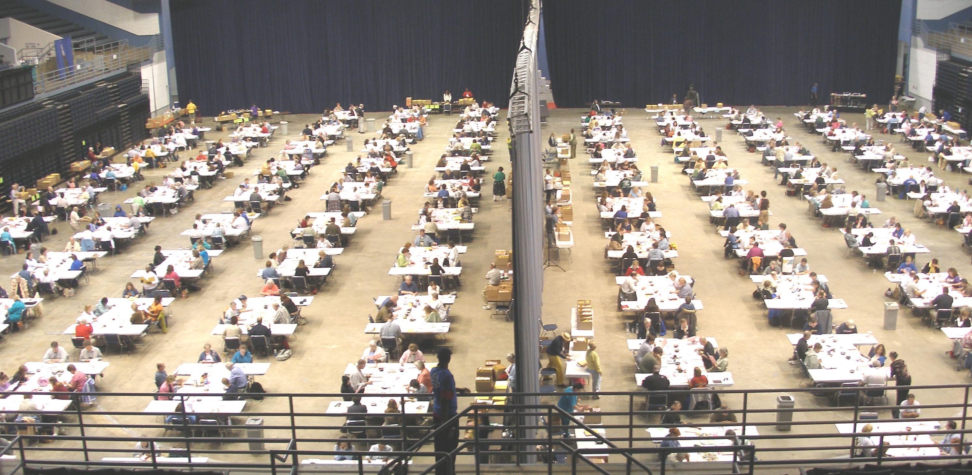
        Readers are trained vigorously

Slide 12
Do the MATH
Students who get a multiple choice
final score of 33 or better
AND
Score at least a five on each essay
Will have enough points to get an exam grade of 3

Slide 13
ESSAY SECTION MATH
Write three mediocre essays
Get a 5 on each (barely passing)
Adjusted score = 45+ points
45 points = exam score of 3
But….SKIP ONE ESSAY
You would need 8s on the other two
Therefore – write all 3 essays

Slide 14
Essay Scoring
We will practice scoring on this prose essay:
Fasting Feasting 2008

