Slide 1
September 14, 2012
AP Literature and Composition

Slide 2
September 14, 2012
Small group discussion for ½ hour
Reconvene and discuss for ½ hour.
For Monday: Using the information obtained, determine whether you feel Raskolnikov is mentally fit to stand trial and whether he should receive the death penalty.

Slide 3
Objectives
Examine pros and cons of the death penalty, analyze the behavior of the unabomber and “The Dark Knight Murderer”, and consider the insanity plea.
Synthesize this information and consider all factors when comparing these people to Raskolnikov.

Slide 4
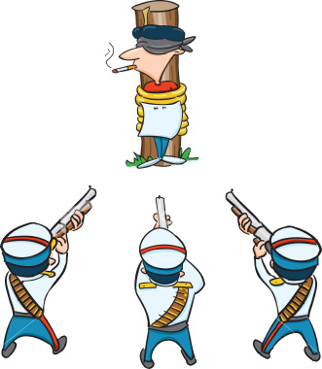
Did YOU Know?
The last US execution by firing squad took place on June 18, 2010 in Utah. Convicted killer Ronnie Lee Gardner was the third person in 33 years to be executed by firing squad, with all three executions taking place in Utah (as of July 8, 2010). Gardner was able to choose the firing squad because he was grandfathered in after Utah outlawed firing squads on May 3, 2004.

