Slide 1
October 12, 2012
English 12

Slide 2
October 12, 2012
PI TEST TODAY!

Slide 3
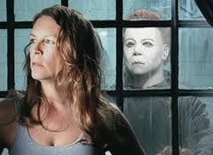
Did YOU know?
Because the movie Halloween (1978) was on such a tight budget, they had to use the cheapest mask they could find for the character Michael Meyers, which turned out to be a William Shatner Star Trek mask. Shatner initially didn’t know the mask was in his likeness, but when he found out years later, he said he was honored.

