Slide 1
October 23, 2012
English 12

Slide 2
October 23, 2012
Get book!
Answer the questions independently on the reading (1/2 hour)
Roundtable discussion be prepared to answer the questions and discuss what honor meant in medieval times

Slide 3
Objectives
RL.11-12.1 Cite textual evidence to support inferences drawn from the text.
RL.11-12.3 Analyze the impact of the author’s choices regarding how to develop and relate elements of a story.
RL.11-12.5 Analyze how an author’s choices concerning how to structure specific parts of a text contribute to its overall structure.
SL .11-12.1c Propel conversations by responding to questions that probe reasoning and evidence.

Slide 4
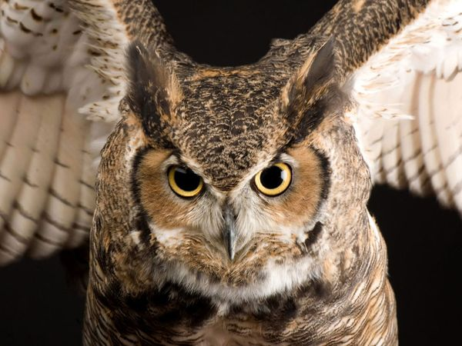
Did YOU know?
The owl is a popular Halloween image. In Medieval Europe, owls were thought to be witches, and to hear an owl's call meant someone was about to die.

