Slide 1
October 26, 2012
English 12

Slide 2
October 30, 2012
Peer Edit!!!
Clean out portfolios
Work on Personal Statement, etc.
Pick Me essay due tomorrow!

Slide 3
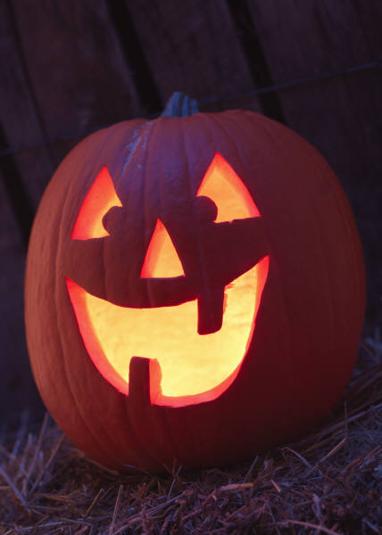
Did YOU know?
Stephen Clarke holds the record for the world’s fastest pumpkin carving time: 24.03 seconds, smashing his previous record of 54.72 seconds. The rules of the competition state that the pumpkin must weigh less than 24 pounds and be carved in a traditional way, which requires at least eyes, nose, ears, and a mouth.

