Slide 1
October 4, 2012
English 12 College Prep

Slide 2
October 4, 2012
Watch History video on Le’Morte d’Arthur.
Take notes
Homework: Read ch 61-80 and do the study guide for FRIDAY

Slide 3
Objectives
SL.11-12.3: Evaluate a speaker’s point of view, reasoning, and use of evidence and rhetoric, assessing the stance, premises, links among ideas, word choice, point of emphasis, and tone used.

Slide 4
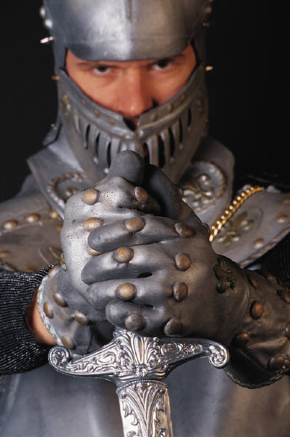
Did You Know?
Starting around 1450, Malory began to be charged with a series of crimes, including attempted murder, rape, sedition, extortion, breaking and entering, theft, and cattle raiding. Malory was imprisoned eight times. He escaped twice but was recaptured.

