Slide 1
September 14, 2012
English 12 College Prep

Slide 2
September 14, 2012
Five minute study time
Reading Quiz over Life of Pi
Discuss Study Guide
Discuss Chapters 1-20
Homework: Chapters 21-40 due Friday along with study guide

Slide 3
Objectives
RL.11-12.4: Analyze the impact of specific word choices on meaning, including words with multiple meanings.
RL.11-12.5: Analyze how an author’s choices concerning how to structure specific parts of a text contribute to its aesthetic impact.

Slide 4
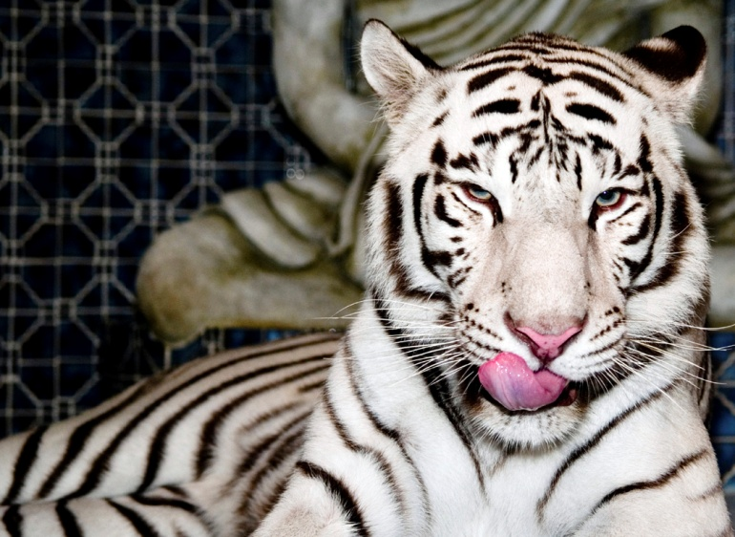
Did You Know?
A tiger can eat 100 pounds of meat a night! Compare that to 400 hamburgers! They need a lot of food because they go days between meals.

