Slide 1
September 16, 2013
English 12 CP

Slide 2
September 16, 2013
Assigned seat! Pass back papers
Evaluating Roadblock worksheet Chapters 20-35 with your elbow partner, discuss all of these, whether you clarified or skipped, etc.
Read chapter 36 silently, making predictions and observations along the way to share with the class.
Share
Go over your notes/sticky notes/quizzes… Part One test tomorrow.
Notes:
Collect Information Sheet
Begin Reading Strategies List

Slide 3
Objective
RL.11-12.1: Cite strong and thorough textual evidence to support analysis of what the text says explicitly as well as inferences drawn from the text, including determining where the text leaves matters uncertain.

Slide 4
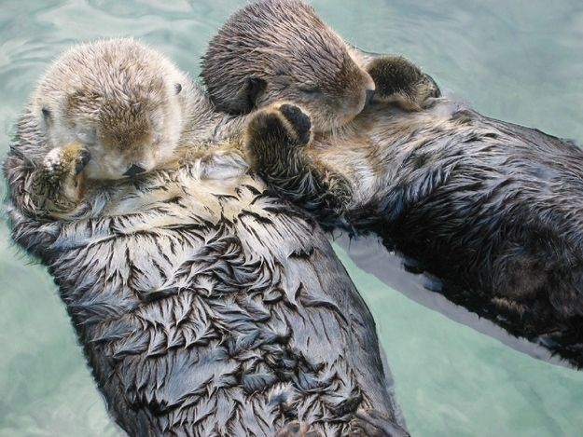
Did You Know?
Sea otters hold each other’s paws when they sleep so they don’t drift apart.

