Slide 1
September 17, 2013
English 12 CP

Slide 2
September 17, 2013
Assigned seat!
Tell me your FAVORITE quote from Part One and why it is your favorite quote.
Read through, talking to the text, chapter 42.
Notes:
Collect Information Sheet
Begin Reading Strategies List

Slide 3
Objective
RL.11-12.1: Cite strong and thorough textual evidence to support analysis of what the text says explicitly as well as inferences drawn from the text, including determining where the text leaves matters uncertain.

Slide 4
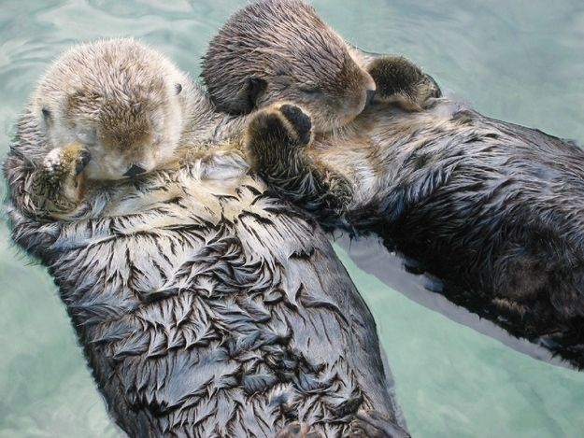
Did You Know?
Sea otters hold each other’s paws when they sleep so they don’t drift apart.

