Slide 1
September 18, 2013
English 12 CP

Slide 2
September 18, 2013
Assigned seat!
Test over Part One today!
When you are finished, read and talk to the text chapters 42-47.
Notes:
Collect Information Sheet
Begin Reading Strategies List

Slide 3
Objective
RL.11-12.1: Cite strong and thorough textual evidence to support analysis of what the text says explicitly as well as inferences drawn from the text, including determining where the text leaves matters uncertain.

Slide 4
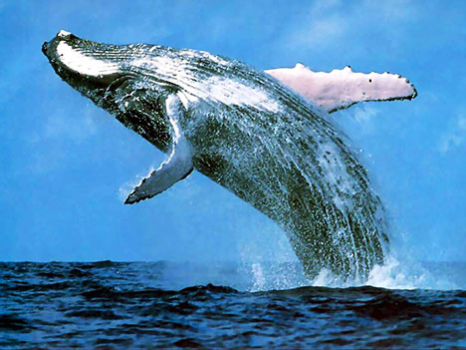
Did You Know?
A blue whale weighs as much as three elephants and is as long as three Greyhound buses

