Slide 1
September 19, 2013
English 12 CP

Slide 2
September 19, 2013
Choose your seat today
5 minute writing
Table talk
Think Aloud
Homework: Read chapter 49-53… Quiz tomorrow!
Notes:
Collect Information Sheet
Begin Reading Strategies List

Slide 3
Objective
RL.11-12.1: Cite strong and thorough textual evidence to support analysis of what the text says explicitly as well as inferences drawn from the text, including determining where the text leaves matters uncertain.

Slide 4
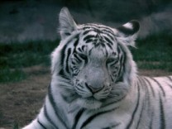
Did You Know?
Tigers can reach a length of up to 3.3 metres (11 feet) and weigh as much as 300 kilograms (660 pounds).

