Slide 1
September 20, 2013
English 12 CP

Slide 2
September 20, 2013
Choose your seat today
Quick Quiz!
Watch Part I of Life of Pi
Homework: Read through chapter 59 for Monday
Notes:
Collect Information Sheet
Begin Reading Strategies List

Slide 3
Objective
RL.11-12.1: Cite strong and thorough textual evidence to support analysis of what the text says explicitly as well as inferences drawn from the text, including determining where the text leaves matters uncertain.

Slide 4
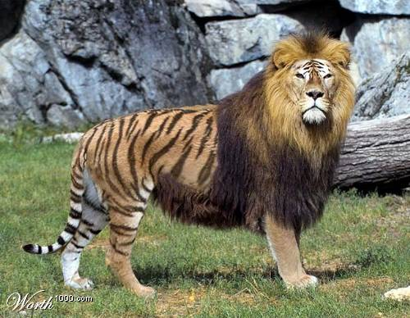
Did You Know?
Tigers that breed with lions give birth to hybrids known as tigons and ligers.

