Slide 1
September 23, 2013
English 12 CP

Slide 2
September 23, 2013
Assigned seat
Questions on own (5 min)
Discussion questions in table groups
Poster
Homework: Read through chapter 63 for tomorrow
Notes:
Collect Information Sheet
Begin Reading Strategies List

Slide 3
Objective
RL.11-12.1: Cite strong and thorough textual evidence to support analysis of what the text says explicitly as well as inferences drawn from the text, including determining where the text leaves matters uncertain.

Slide 4
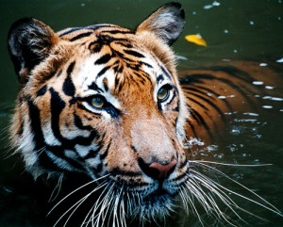
Did You Know?
Tigers are good swimmers and can swim up to 6 kilometers.

