Slide 1
September 24, 2013
English 12 CP

Slide 2
September 24, 2013
Be with Group
Poster
Homework: Read through chapter 71 for tomorrow
Notes:
Collect Information Sheet
Begin Reading Strategies List

Slide 3
Objective
RL.11-12.1: Cite strong and thorough textual evidence to support analysis of what the text says explicitly as well as inferences drawn from the text, including determining where the text leaves matters uncertain.

Slide 4
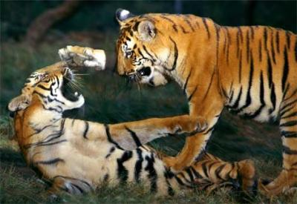
Did You Know?
Territory disputes between male tigers are often settled by displays of intimidation rather than physical aggression

