Slide 1
September 9, 2013
English 12 CP

Slide 2
September 9, 2013
Sit at any table you’d like today!
Quiz: On a separate sheet of paper, write down three questions you had during your reading (what is on your sticky notes), four observations you had during your reading, and three roadblocks.
With elbow partner, Discuss Chapter 1 and 2 for Life of Pi
Discuss the chapters
Discuss what reading strategies you used to make sense of the text and aid in your comprehension.
Add more items to the Reading Strategies List for the class…
HOMEWORK: Read and Talk to the Text Chapters 3 – 6 and be prepared to discuss and take quiz
Notes:
Collect Information Sheet
Begin Reading Strategies List

Slide 3
Objective
RL.11-12.1: Cite strong and thorough textual evidence to support analysis of what the text says explicitly as well as inferences drawn from the text, including determining where the text leaves matters uncertain.

Slide 4
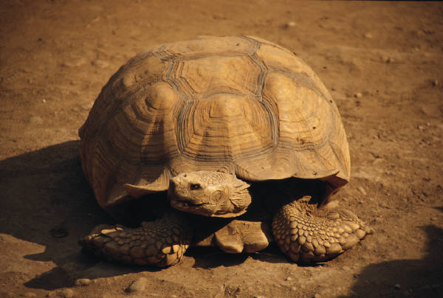
Did You Know?
A turtle can breathe through it’s butt. Hahaha, Funny!

