Slide 1
September 26, 2012
English 11 Agenda

Slide 2
September 26, 2012
Go over Scarlet Letter Test
Type One
Read “Of Plymouth Plantation” with your partner and summarize each section
Homework: Read through ch 13 for Friday and do study guide and vocab

Slide 3
Objectives
RI.11-12.9: Analyze seventeenth-century foundational U.S. documents of historical and literary significance for their themes, purposes, and rhetorical features.
RI.11-12.2: Determine two or more central ideas of a text and analyze their development over the course of the text, including how they interact and build on one another to provide a complex analysis; provide an objective summary of the text.
SL.11-12.4: Present information, findings, and supporting evidence, conveying a clear and distinct perspective, such that listeners can follow the line of reasoning, alternative or opposing perspectives are addressed, and the organization, development, substance, and style are appropriate to purpose, audience, and a range of formal and informal tasks.

Slide 4
Type One
Hard times can bring people closer together or tear them apart. For example, in a blackout after a serious storm, people could respond by sharing supplies or by stealing what they need from unprotected homes. When does facing hardship become a source of strength and unity rather than one of distrust and division?

Slide 5
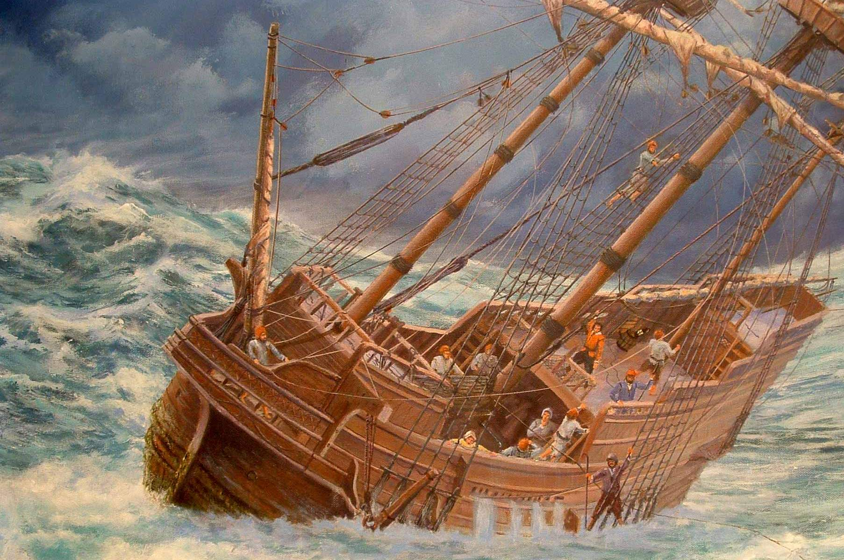
Quotable Quote
“The difficulties were many, but not invincible.”
- William Bradford

