Slide 1
October 9, 2012
English 11

Slide 2
October 9, 2012
Go over previous Scarlet Letter tests and housekeeping!
Discuss the History Channel Video “The Salem Witch Trials” and fill out worksheet as you go
Tests to make up? Silent Reading time? Etc.

Slide 3
Objectives
SL.11-12.3: Evaluate a speaker’s point of view, reasoning, and use of evidence and rhetoric, assessing the stance, premises, links among ideas, word choice, point of emphasis, and tone used.

Slide 4
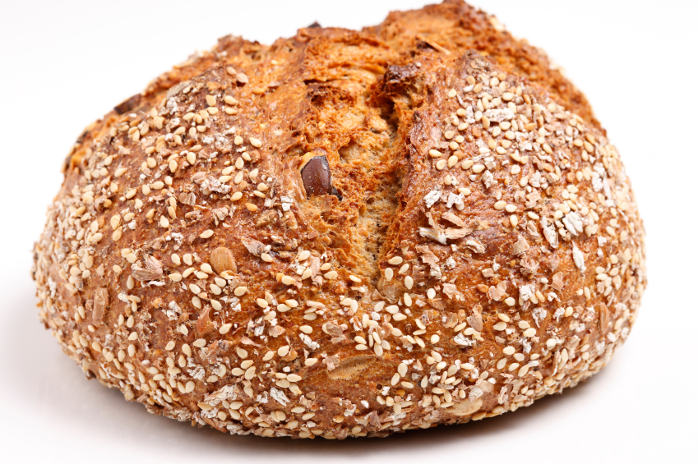
Did you know?
Ergot fungus grows on rye wheat. It is unaffected by freezing temperatures and is passed into the body through bread made from the wheat or milk from cows that eat the wheat. It causes damage to the central nervous system. It is more or less severe depending on the consumption.

