Slide 1
November 5, 2012
English 11

Slide 2
November 5, 2012
Watch Rocketbook on Act IV and do reading guide
Answer questions at the end of Act IV
Act IV Test TOMORROW

Slide 3
Cast list – 2nd hour
Francis Nurse: Michael
Cheever: Sean
Herrick: Eric
Hathorne: Caleb
Martha: Brittani
Danforth: Matt
Sarah Good: Charlotte
Rev. Parris: Paul
Betty: Katie
Tituba: Jessie
Abigail: Kennedy
John: Jonah
Elizabeth: Riley
Susanna: Hannah
Ann Putnam: Jeni
Thomas: Taylor
Mercy Lewis: Aliese
Mary Warren: Cheyanne
Rebecca Nurse: Paige
Giles Corey: Triston
John Hale: Derek

Slide 4
Cast list – 5th hour
Francis Nurse: Ryan
Cheever: Matt
Herrick: Roop
Hathorne: Peyton
Martha: Jessica
Danforth: Jordan
Sarah Good: Jessica
Rev. Parris: Tucker
Betty: Sam
Tituba: Tara
Abigail: Leah
John: Dylan
Elizabeth: Melissa
Susanna: Virginia
Ann Putnam: Karen
Thomas Putnam: Kyle
Mercy Lewis: Cassidy
Mary Warren: Courtney
Rebecca Nurse: Kendra
Giles Corey: Simon
John Hale: Tom

Slide 5
Objective
RL.11-12.1: Cite textual evidence to support analysis of what the text says explicitly as well as inferences drawn from the text, including determine where the text leaves matters uncertain.
RL.11-12.3: Analyze the impact of the author’s choices regarding how to develop and relate elements of a drama.
RL.11.12.5: Analyze how an author’s choices concerning how to structure specific parts of a text contribute to its overall structure and meaning as well as its aesthetic impact.

Slide 6
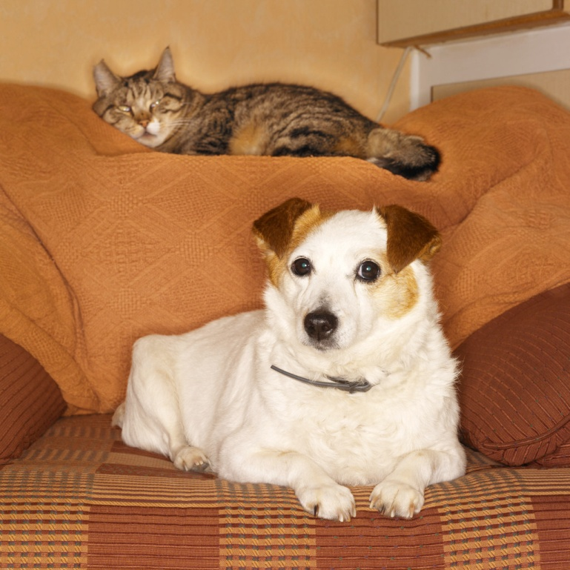
Did YOU know?
Hartsdale New York has a pet cemetery with more than 12,000 pets buried.

