Slide 1
November 7, 2012
English 11

Slide 2
November 7, 2012
Begin Performance Assessment (LARGE PART OF THIS MARKING PERIOD GRADE!!!)
PreWriting and Conferencing… Handouts and THESIS STATEMENT due today
Highlight passages in the packet that help support your opinions of the play
Write down passages from the play that stand out to you and parallel what you think about historically
Begin introduction!!!

Slide 3
Objective
RI.11.12. 1 Cite textual evidence to support analysis of what the text says explicitly.
RI.11-12. 6 Determine an author’s point of view or purpose in a text in which the rhetoric is particularly effective, analyzing how style and content contribute to the power, persuasiveness, or beauty of the text.
RI.11-12. 7 Integrate and evaluate multiple sources of information presented in different media or formats as well as in words.
W.11-12. 2 Write informative/explanatory texts to examine and convey complex ideas, concepts, and information clearly and accurately through the effective selection, organization, and analysis of content.
W.11-12. 2b Develop the topic thoroughly by selecting the most significant and relevant facts, concrete details, or quotations

Slide 4
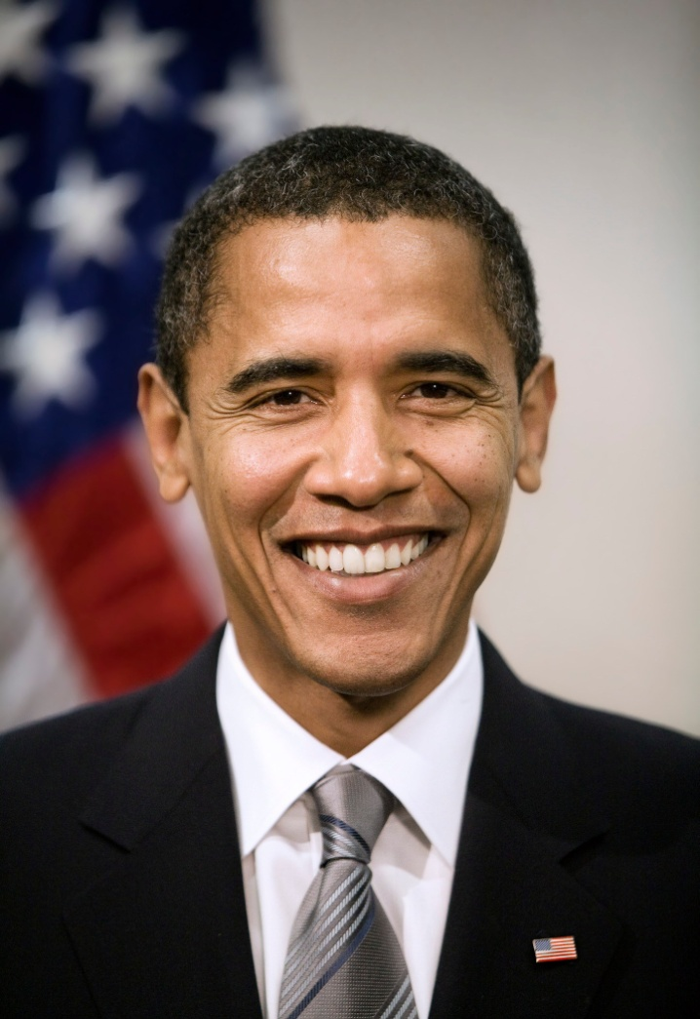
Did YOU know?
President Barak Obama is the projected winner of the election and will continue to be your President for the next 4 years.

