Slide 1
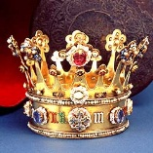
Medieval Britain
Historical Tidbits

Slide 2
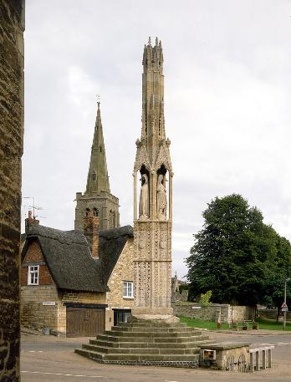
Edward I and Queen Eleanor
When his queen dies in northern England in 1290, the body is taken back to London. He has monuments erected at every town the procession stopped at for the night. The monuments are referred to as “Eleanor Crosses.”

Slide 3
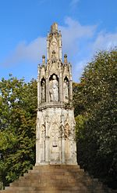
A deep and abiding love
The king wrote letters to archbishops, seeking prayers for the soul of the wife "whom living we dearly cherished, and whom dead we cannot cease to love.".

Slide 4
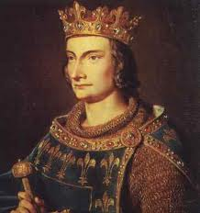
What a great family, right? Not exactly.
Edward I’s son, Edward II, married Isabella, a princess of France. Her dad was the king.

Slide 5
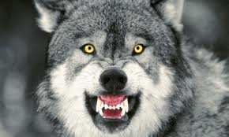
Their marriage wasn’t quite as happy as Edward’s parents’. Isabella was called “The She-Wolf of France” and was suspected of having a hand in her husband’s imprisonment and death.

Slide 6
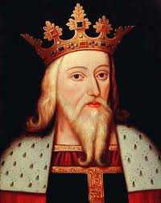
But that’s OK! Her son, Edward III, can now become king!

Slide 7
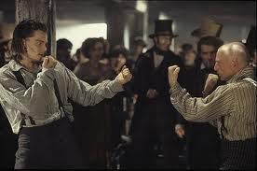
But there’s a problem back in France.

Slide 8
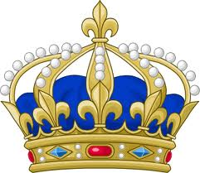
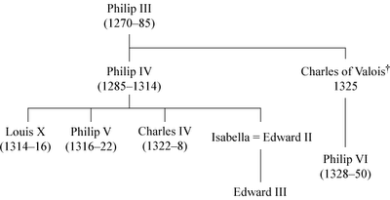
NO!!!! Girls have cooties!!!!
MINE!
Notes:
Louis X loved tennis. Following a particularly exhausting game, Louis drank a large quantity of cooled wine and subsequently died of either pneumonia or pleurisy, although there was also suspicion of poisoning.
Phillip V became ill and died while on campaign in the south of France.
Charles IV just died.

Slide 9
Edward III
He decided that his claim to the French throne was better than the current king, so he started the fight.

Slide 10
The French
They don’t acknowledge a female as an heir to the throne. They can’t have a “Queen” of France. But they do have a few grandsons of past kings hanging around.
They say that’s a much better claim to the throne than Edward’s, whose claim came through the female line.

Slide 11
It’s On!
The Hundred Year’s War lasted about 116 years.
(1337-1453)

Slide 12
Happy 1453! Glad all that war stuff is settled.
2 Years Later ….

Slide 13
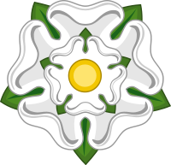
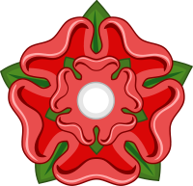
The War of the Roses
VS.
House of York
House of Lancaster

Slide 14
Briefly:
Henry of Bolingbroke deposed his cousin Richard II and was crowned as Henry IV. Bolingbroke's son Henry V maintained the family's hold on the crown, but when Henry V died, his heir was the infant Henry VI.
The Lancastrian claim to the throne descended from John of Gaunt, 1st Duke of Lancaster, the fourth son of Edward III.
Henry VI's right to the crown was challenged by Richard, Duke of York, who could claim descent from Edward's third and fifth sons, Lionel of Antwerp and Edmund of Langley, 1st Duke of York.
(Find and circle all these folks on your handout.)
Notes:
Have a pedigree chart for students to refer to.

Slide 15
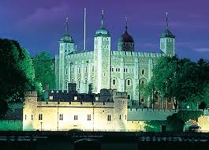
Edward IV
Edward IV won complete victory at Tewkesbury (May 1471) where the Lancastrian heir, Edward, Prince of Wales, was executed after the battle. Henry VI was murdered in the Tower of London several days later, ending the direct Lancastrian line of succession.
(circle and cross out Henry VI and his son Edward, on your handout.)
.

Slide 16
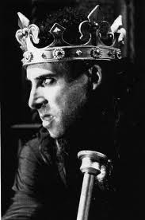
Richard III
King Edward died unexpectedly in 1483. His surviving brother, Richard of Gloucester, first tried to become ruler during the minority of Edward's son, Edward V, but then just seized the throne for himself.
Of course, he had a few nephews to get rid of.

Slide 17
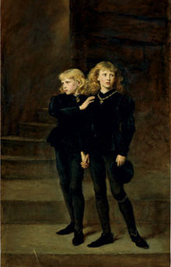
The Princes in the Tower
To “protect” his nephews from harm, Richard III had them taken from their mother and put in the Tower of London. They were 10 and 13. They were never seen again.

Slide 18
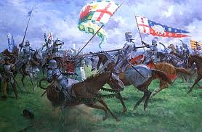
Bosworth Field
This was the last battle on English soil that was fought by Knights in armor.
Richard III didn’t do so well, and was killed by forces led by Henry Tudor.
(cross off Richard III from your handout, and circle Henry Tudor)

Slide 19
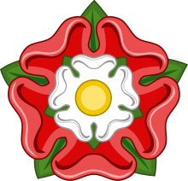
Henry Tudor
As soon as Henry Tudor won, he married Princess Elizabeth, the oldest child of the last York King, if you don’t count her uncle, Richard III. Since the Tudors had a claim to the throne through the Lancaster side, the warring family was finally reunited.
Notes:
The Tudor Rose combines both the white of York with the red of Lancaster.

Slide 20
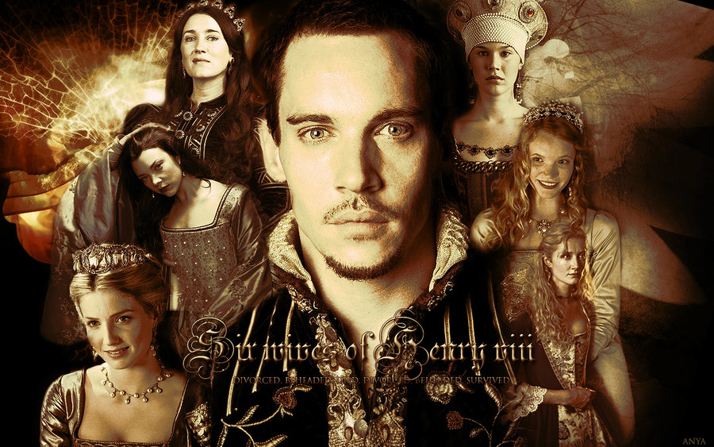
The son of Elizabeth of York and Henry Tudor became Henry VIII

